Slide 1
CMBS Modeling RMBS Modeling vs. CMBS Modeling
RMBS Modeling has some fundamental differences from CMBS Modeling. The differences are introduced by the securities characteristics.
The differences are noticed in terms of different collateral type, collateral size, default impact, documentation, and the applicability of the statistical models.
Collateral
Type
RMBS
CMBS
Trend to be backed by relatively homogeneous collateral - mortgages are secured by single family residences
Trend to be more heterogeneous collateral - mortgages are secured by a variety of property types including office, retail, multifamily, industry and hospitality
Collateral
Size
Each securitization typically contains thousands of mortgages
Most securitizations contain approximately 15-300 mortgages
Generally the top 15 loans account for approximately 50% of the balance of a CMBS trust
Default
Impact
The default of a single mortgage does not tend to materially impact deal performance
The default of a single mortgage can have a significant impact to the owners of all related CMBS tranches
Documents
More consistency in loan documentation for residential mortgages
Loan documentation tends to be unique for each borrower/mortgage
Statistical
Modeling
Modeling is typically based on law of large numbers, applying a probabilistic approach to projecting performance outcome (e.g. CDR, CPR, Severities, etc.)
Commercial real estate is less amenable to statistical modeling due to idiosyncratic aspects of each underlying commercial property and mortgage
Notes:
The draft you sent over had this title. It doesn’t look correct?

Slide 2
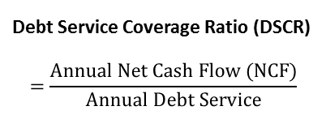
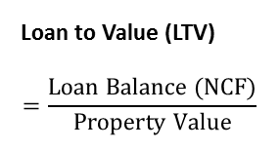
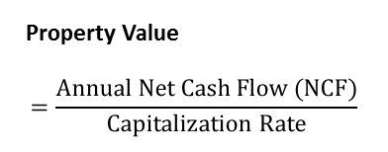
CMBS Modeling Commercial Mortgage Loan basics
Similar as residential properties, the capital structure for a commercial property also includes mortgage part and borrower equity part.
The risk terms inherited with commercial mortgage include Term Default Risk, Maturity Default Risk and Extension Risk.
Capital Structure of a Sample Property
Life Cycle of a Sample Commercial Mortgage Loan
Commercial mortgage have inherent risks to the lender
Term Default Risk:
Borrower is unable to meet its interest obligations and defaults on its mortgage before maturity
Maturity Default:
Borrower is unable to refinance or payoff loan balance at maturity
Extension Risk:
Servicer/Lender may extend loan maturity
Mortgage
Mortgage
LTV
= 80%
Total
Property
Value = 100%
Maturity Default Risk
Borrower
Equity
Term Default Risk
Extension Risk
Year 0
Year 10
Year 12
Original Loan Issuance
Stated Loan Maturity
Final Payoff
Key Term Definitions
Property Value
$$=\frac{Annual Net Cash Flow (NCF)}{Capitalization Rate}$$
Loan to Value (LTV)
$$=\frac{Loan Balance (NCF)}{Property Value}$$
Debt Service Coverage Ratio (DSCR)
$$=\frac{Annual Net Cash Flow (NCF)}{Annual Debt Service}$$
Notes:
The draft you sent over had this title. It doesn’t look correct?

Slide 3
CMBS Modeling Loan outcome projection
Loan outcomes are determined by a series of DSCR and LTV tests over time.
A monthly test logic will be applied to each loan to determine its monthly loan outcome.
Loan Outcomes
During initial term or extension | Term Default | DSCR < Default
At original maturity | Pay off | LTV < pay off LTV requirement
 | Extension | LTV between extension LTV bounds
 | Default | LTV > extension LTV limit
At extension maturity | Default | LTV > Refinance Threshold
Default, Extension and Payoff Logic Tree
Yes
Is DSCR < DSCR Default Trigger?
No
Loan is current, repeat process next month
Is loan at maturity
No
Yes
Is loan LTV < pay-off LTV requirement?
Yes
Loan pays off
No
At extension maturity is
LTV < Refinance Threshold?
Is Loan LTV < extension LTV limit
Yes
Maturity
Extension
Yes
Loan pays off
No
No
Term Default
Maturity Default
Maturity Default
All
Defaults
Loan Workout Period and Loss Calculation
Notes:
The draft you sent over had this title. It doesn’t look correct?

